Slide 1


TATA – ONLINE RETAIL data ANALYSIS

Slide 2
AGENDA
Problem
The analytics team
Process
Insights

Slide 3
PROBLEM
Management seeks to understand the primary drivers behind the current success of the business and aims to analyze them to inform strategic planning for the upcoming year. They are keen on examining metrics related to both operational and marketing aspects. Additionally, as part of their expansion plans, they are interested in identifying high-performing areas to maintain focus on successful strategies. Furthermore, they express a desire to explore various metrics based on demographic data available within the dataset.

Slide 4


THE ANALYTICS TEAM
BELOWEI PETER DITORU-MUJE

Slide 5
THE PROCESS
Understanding the data given.
Data cleaning.
Data modelling.
Data analysis.
Uncover insights.

Slide 6
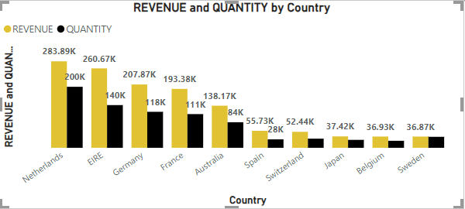
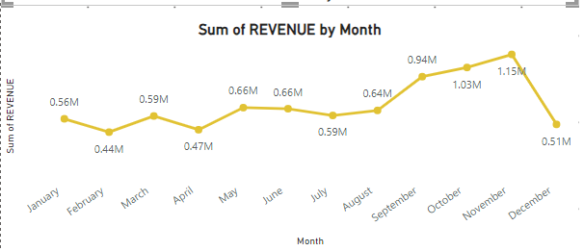
INSIGHTS
Top 10 countries by revenue
REVENUE BY MONTH

Slide 7
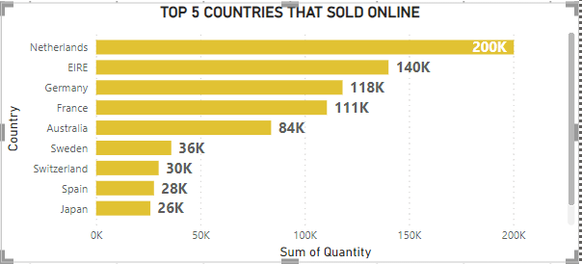
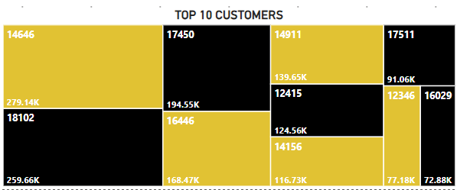
INSIGHTS
TOP 5 COUNTRIES THAT SOLD ONLINE
Top 10 customers

Slide 8
INSIGHTS
TOTAL REVENUE
TOTAL NUMBER OF CUSTOMERS
BEST PERFORMING MONTH
8.82M
4338
NOVEMBER

Slide 9
THANK YOU!!!

